Slide 1

Automated vulnerability hunting
Where are we now ?

Slide 2

whoami
Salim LARGO | @2ourc3
Security Engineer @ Nexova - RF Pentest team
Focusing on vulnerability research and DAST/SAST techniques
Github https://github.com/20urc3 | https://bushido-sec.com/

Slide 3


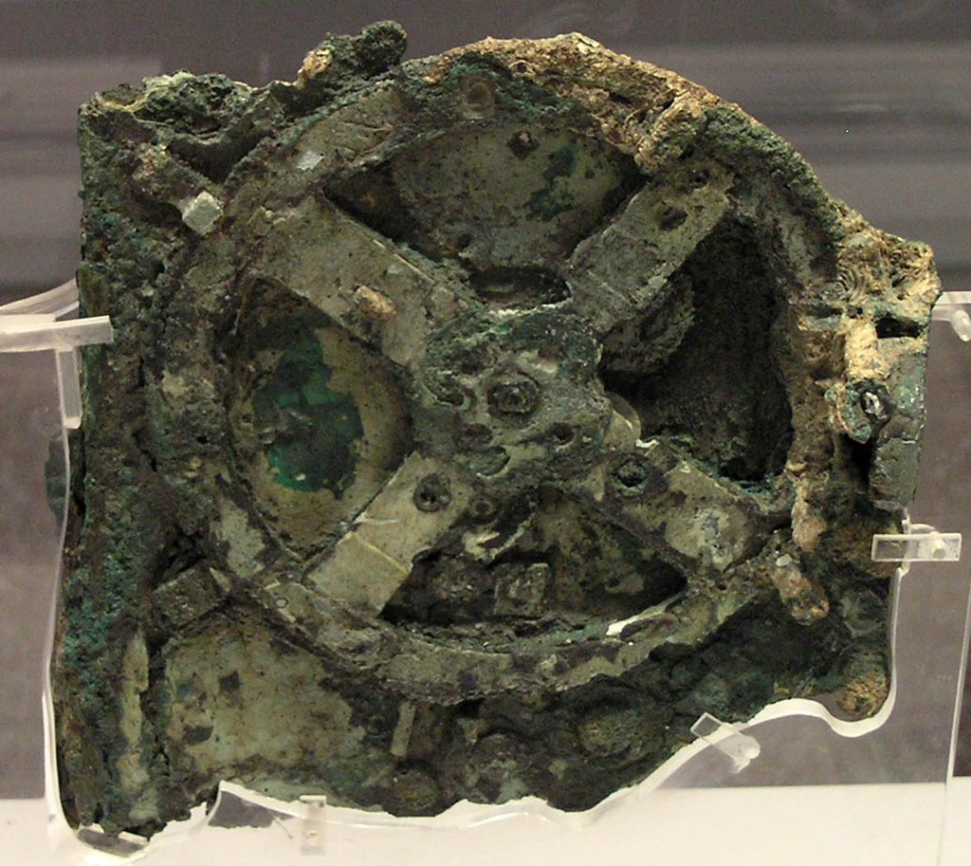
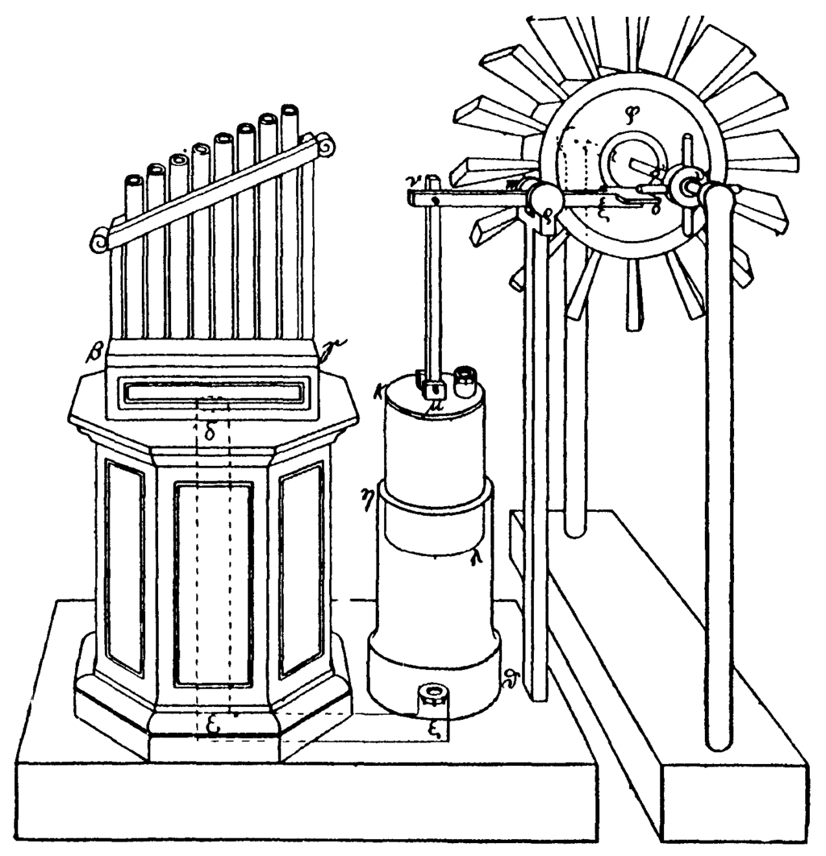

Slide 4
Cleverness + Laziness
(and a bit of nerdiness)

Slide 5





Analysis
Tweak
Refine
Manual work
Profit!

Slide 6



Tooling
LLM
Distribution

Slide 7
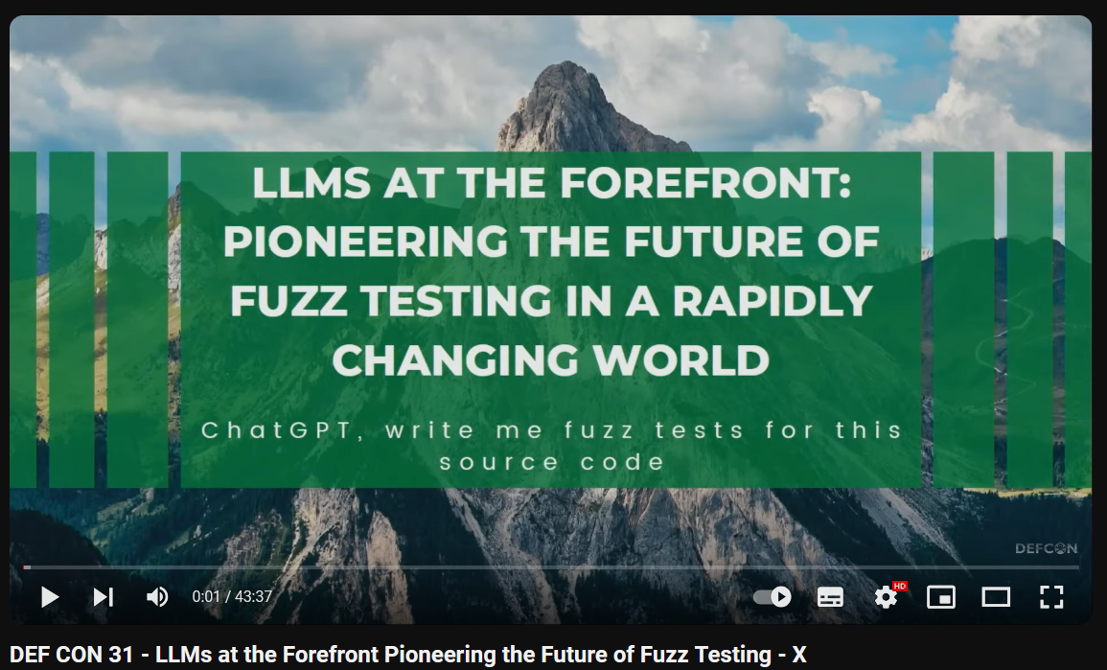
https://www.youtube.com/watch?v=k9gt7MNXPDY

Slide 8
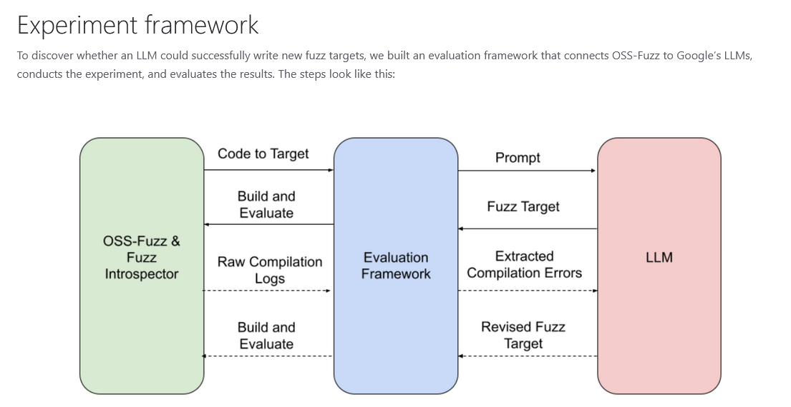
https://google.github.io/oss-fuzz/research/llms/target_generation/

Slide 9
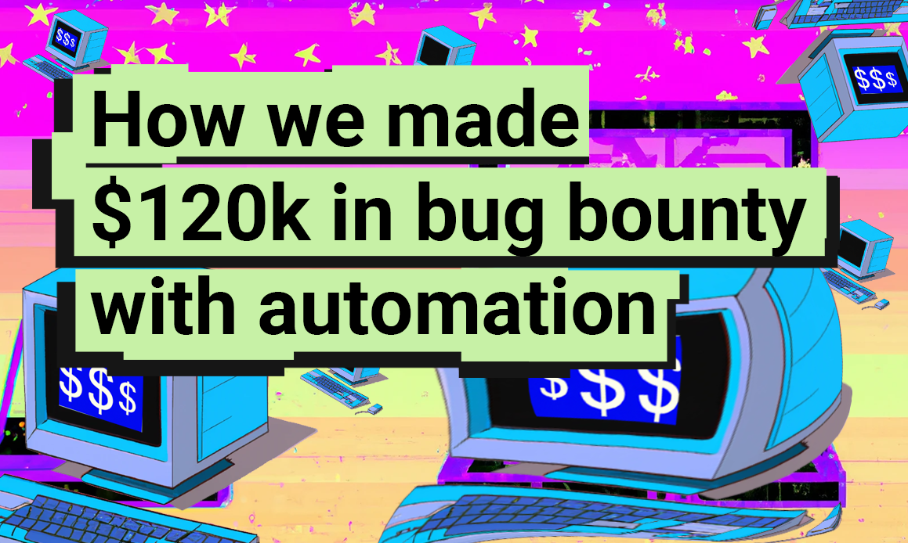
https://blog.vidocsecurity.com/blog/2022-summary-how-we-made-120k-bug-bounty-in-a-year/

Slide 10
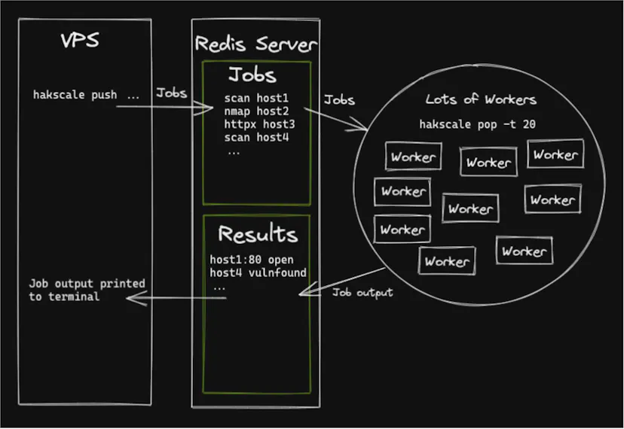
https://labs.detectify.com/ethical-hacking/hakluke-creating-the-perfect-bug-bounty-automation/

Slide 11




Monitoring bug bounty websites
Automated reverse engineering
SAST/DAST
Profit
ZDI-CAN-24307 7-Zip CVSS: 6.5 2024-06-26 2ourc3

Slide 12
Lesson learned

Slide 13
References:
https://en.wikipedia.org/wiki/Antikythera_mechanism
https://en.wikipedia.org/wiki/Hero_of_Alexandria
https://en.wikipedia.org/wiki/Hero_of_Alexandria
https://github.com/Vsimpro/f3d
https://blog.vidocsecurity.com/blog/2022-summary-how-we-made-120k-bug-bounty-in-a-year/
https://google.github.io/oss-fuzz/research/llms/target_generation/
https://www.youtube.com/watch?v=k9gt7MNXPDY
https://github.com/20urc3/Sekiryu

Slide 14
- https://github.com/sullo/nikto
- https://portswigger.net/burp
- https://www.tenable.com/products/nessus
- https://github.com/projectdiscovery/nuclei
- https://www.kali.org/tools/dirb/
- https://www.kali.org/tools/dirbuster/
- https://github.com/OJ/gobuster
- https://github.com/tomnomnom/fff
- https://github.com/lanmaster53/recon-ng
- https://sqlmap.org/
- https://github.com/laramies/theHarvester
- https://github.com/ffuf/ffuf
- https://nmap.org/
- https://www.cloudamqp.com/blog/part1-rabbitmq-for-beginners-what-is-rabbitmq.html
- https://codeql.github.com/
- https://clang-analyzer.llvm.org/
- https://cppcheck.sourceforge.io/
- https://semgrep.dev/
- https://github.com/google/fuzzbench
- https://github.com/AFLplusplus/AFLplusplus
- https://github.com/AFLplusplus/LibAFL
- https://github.com/googleprojectzero/winafl
- https://github.com/googleprojectzero/Jackalope
- https://github.com/google/honggfuzz
- https://github.com/google/syzkaller
- https://github.com/googleprojectzero/fuzzilli
- https://llvm.org/docs/LibFuzzer.html

